Slide 1
MCTV Limited
Group Project by:
Remigija Vindasiute(x17432284)
Ioana Avram(x17448556)

Slide 2
Introduction
MCTV limited is a small retail company located in Limerick.
Main products of this company are TV’s.
Company was created by Michael Cooney and his wife Doreen.
The staff consists of 5 people currently.
4 out of 5 staff members are family members.

Slide 3
Division of the Tasks
Database Tasks:
Tables/Reports/Forms (Ioana)
Queries/Suggestion Form/Data (Ioana)
Customisation (Remigija)
UML tasks:
Pick actors/pick use cases (Remigija)
Make descriptions for use cases (Remigija and Ioana)

Slide 4
Division of the Tasks
WordPress Tasks:
Choose pages and layout/add content (Remigija)
Individual Report tasks:
Make a report (Remigija and Ioana)
Presentation Tasks:
Make slides/ add content/choose layout (Remigija)
Other Tasks:
Create GitHub repository/trello boards/Gantt Chart (Remigija)
Choose a colour scheme (Remigija)

Slide 5
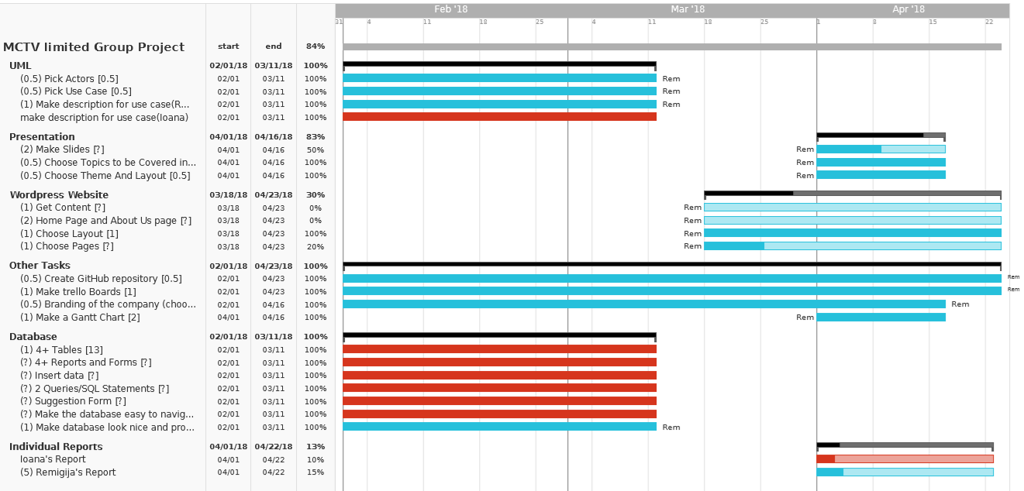
Division of the Tasks
Gantt Chart: Red=Ioana; Blue=Remigija

Slide 6
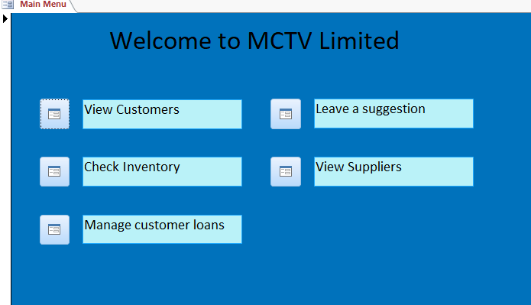
Overview of Database/UML
Main Menu of the Database:

Slide 7
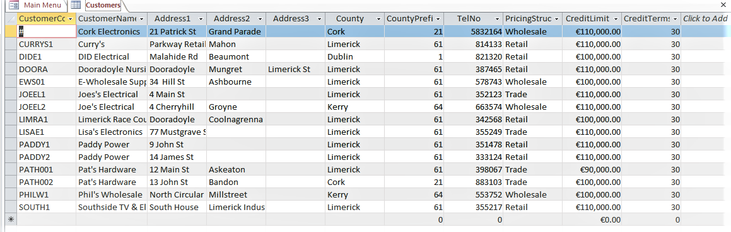
Overview of Database/UML
A sample table in the Database:

Slide 8
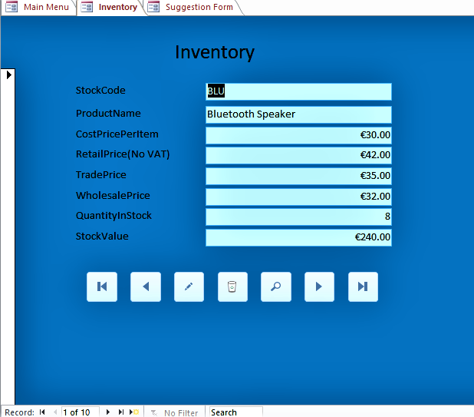
Overview of Database/UML
A sample Form in the database:

Slide 9
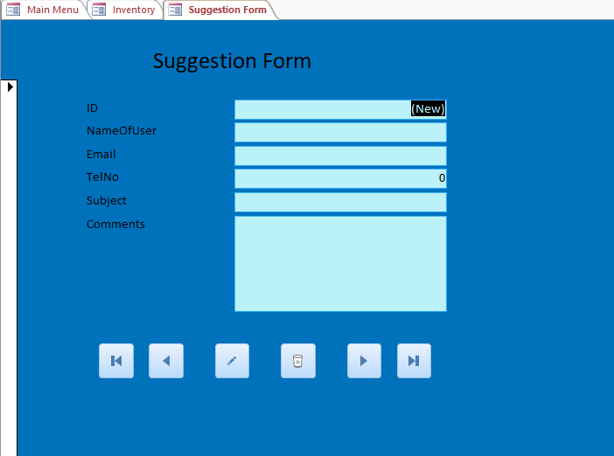
Overview of Database/UML
Suggestion Form:

Slide 10
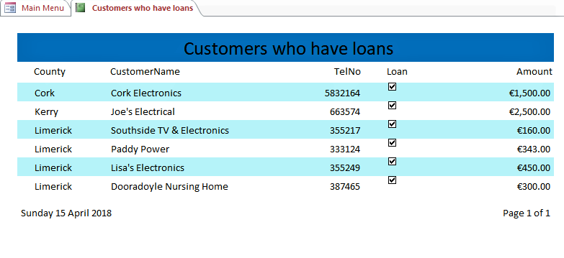
Overview of Database/UML
A sample Report in the Database:

Slide 11
Overview of Database/UML
UML diagram:

Slide 12
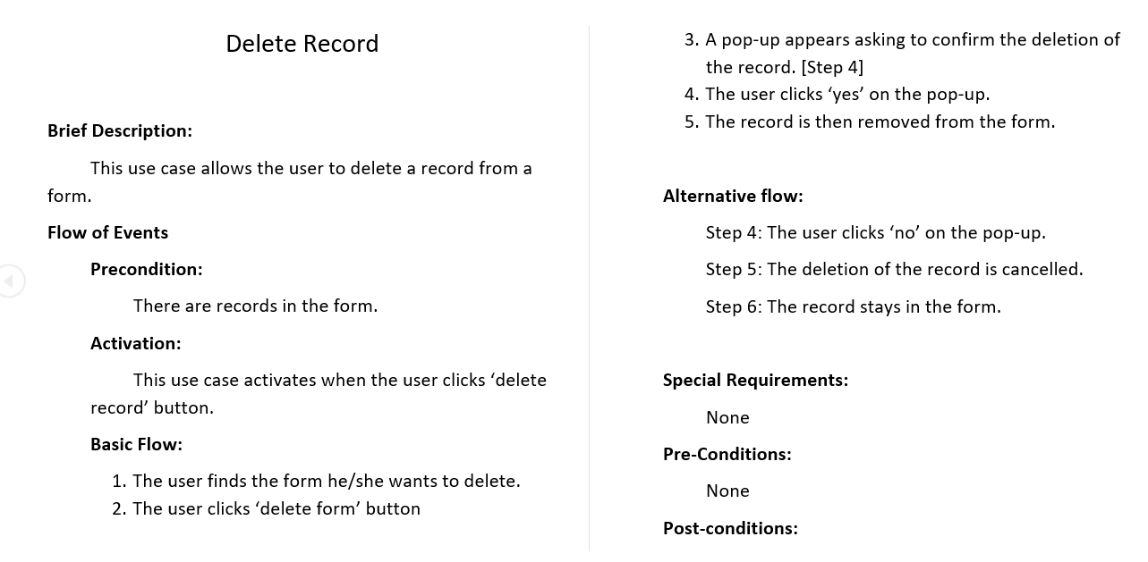
Overview of Database/UML
UML description by Remigija:

Slide 13
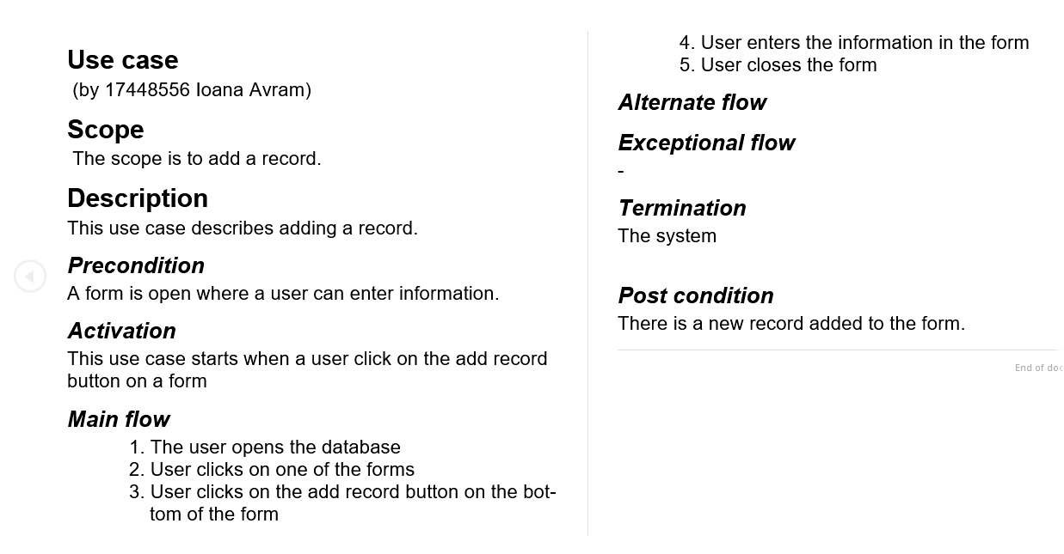
Overview of Database/UML
UML description by Ioana:

Slide 14
Software investigated Ioana’s Report
Cloudways
https://www.cloudways.com/en/
Cloudways is a hosting platform on the cloud
It’s easy to use and allows scaling for websites with a lot of traffic (or even small traffic)
It’s good for e-commerce stores because it has addons and plugins. As well as reliable maintenance and up time. And it works with WordPress.
It also has top class strong security and automated backup at a reasonable price.

Slide 15
Software investigated Remigija’s Report
Airtable
https://airtable.com/
Airtable is a cloud-based collaboration service.
It makes organising anything from anywhere and with anyone easy.
Airtable has desktop and mobile apps, that make it easy to edit, collaborate and comment in real time.
Airtable syncs the changes across all devices instantly.

Slide 16



Branding
The colour scheme we chose for the company consists mainly of various shades of blue. These colours include:
Other colours used: Black and White.
Strong Blue; Hex code: #0072BC
Very Soft Cyan; Hex code: #BAF2F8
Vivid Blue; Hex code: #33ACFF

Slide 17
Conclusion
There are many areas in which the company could improve, but at this point it is not clear what will be prioritised.
However, with the $100,000 investment, there is no doubt that something will change.
Whichever family member’s proposal for the investment is accepted, will decide where the company will head towards.

Slide 18

THE END

